Slide 1
A Final Update A Little Bit Slower Than Light
By: Calvin Brown, Matt Porter, and Sean George

Slide 2
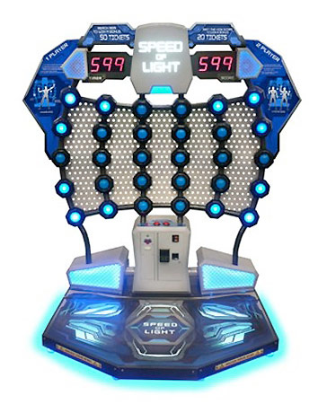
Recap
We derived inspiration from the arcade game known as “Speed of Light”.
After pressing a lit button, another unlit button lights up at random and you get a point adding to the current combo. Pressing an unlit button takes a point away ending the current combo.
The objective of the game is to get the highest score within the time limit in single player or multiplayer mode.

Slide 3
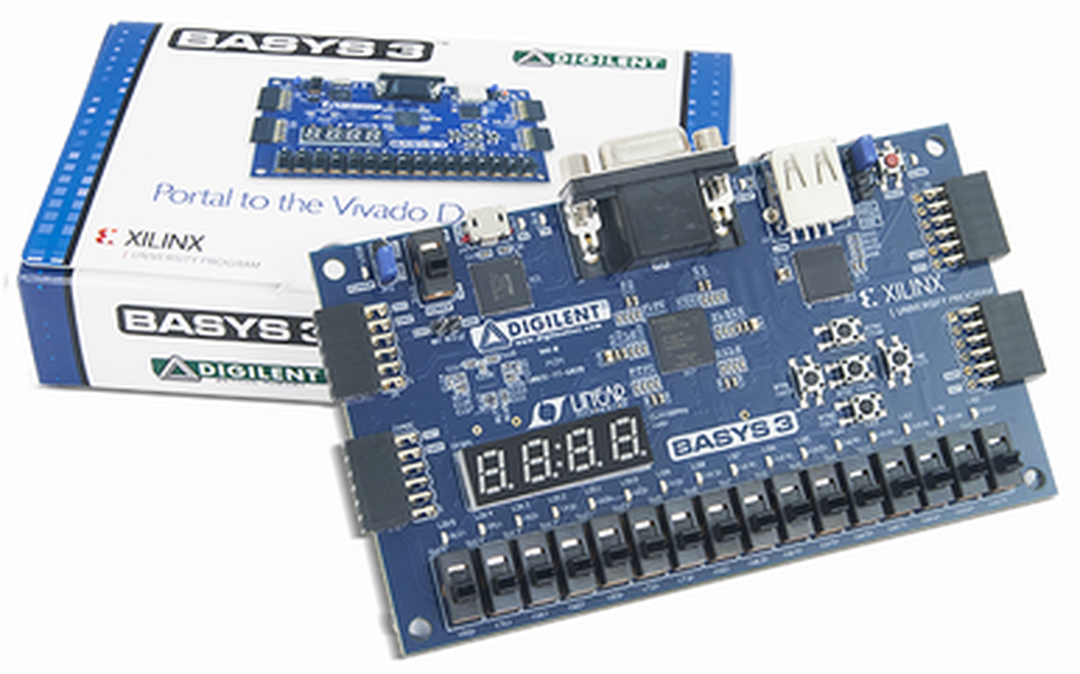
Recap Cont...
Our version of the game works similarly to the real life counterpart, just modified to fit on the Basys 3 board.
Instead of buttons, we use switches corresponding to an LED.
For a score/winner reveal, we use the 7 segment display.
The center button is used to start/stop the game for singleplayer and the top button does the same for multiplayer.

Slide 4
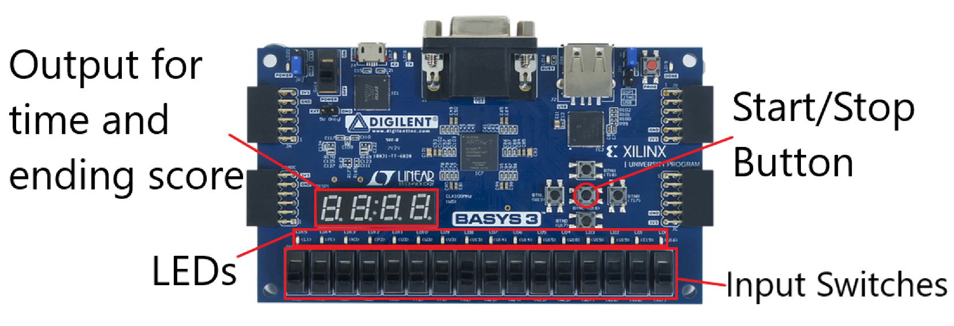
Completed Implementations
Pseudo-randomized sequence of LEDs (although predictable, is random enough for our purposes).
Tallying/Scoring of the user’s point total in a single player game.
Displaying the score to the 7 segment display.

Slide 5
Completed Implementations Cont...
Switch input for detecting if the user pressed the correct LEDs.
Multiplayer
Multiplayer scoring (left two digits of 7 segment displays are player one and the right two are player two).

Slide 6
Shortcomings
Our original goal was to implement a timer, as well as a combo function. However, we were unable to complete these components in the allotted time.
We were at one point able to implement a timer that could count down from 30 to 0, but the game would not end appropriately while the timer would just reset and count down again.
We decided not to implement the combo functionality due to a bug that we could not solve that causes switch inputs to occasionally not register, regardless if they are right or wrong. This would have likely caused the player(s) to lose the combo outside of their control.

Slide 7
Top Module
The top module controls the on/off state of the singleplayer or multiplayer game, keeps track of scoring, and handles the seven segment display output.
There are four modes that the top module can be in: single player mode, single player score display, multiplayer game, and multiplayer winner display.
During either game, the current score is shown. In multiplayer, the seven segment display shows the player 1 score in the first two digits and the player 2 score in the last two digits.
Single player score display shows the final score of the singleplayer game, and the multiplayer winner display shows the winner (1 or 2) of the multiplayer game.

Slide 8
Additional Modules
There are two modules that contribute to the main functionality of the game, LFSR4 and LFSR5. The former is used for two players, while the latter is used for only a single player. Both use essentially the same code, except LFSR4 only controls 8 LEDs and 8 switches at a time, while LFSR5 controls all 16 of each at a time.
The details of the processes of these modules are explained in subsequent slides, but the main sections are the pseudo-randomization and scoring.
Additional modules used are CDiv, a clock divider, SingPul, a pulse generator, and Debounce, a combination of CDiv and SingPul for button input.

Slide 9
Randomization Process
The randomization is based on a Linear Feedback Shift Register (LFSR)
In singleplayer, a 5-bit LFSR is used for the necessary 16 combinations, with the extra combinations used for duplicate LED output.
In multiplayer, each instantiation of the LFSR4 modules uses a 4-bit LFSR for the necessary 8 combinations, with the extra combinations used again for duplicate LED output.

Slide 10
Scoring Process
Switch inputs trigger a score change on a rising or falling edge (when the switches are moved up or down). The input switch array is stored into a temporary array delayed by one clock cycle, such that a change in the position of a switch will only immediately be reflected in the input and not the temporary array.
In the process, each switch is individually checked if a rising or falling edge occurred, after which this input is compared against the current LED state. Score increases on a hit or decreases on a miss.

Slide 11
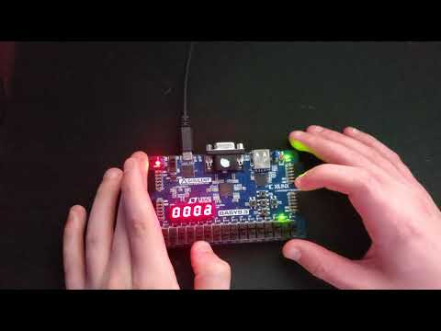
Demo

Slide 12
That’s All
Any Questions?

